Slide 1
Reminders
Homework 8 due Date is Due by Midnight on 4/1.
If doing HW option, be sure to do IRB training ASAP
Quiz on Chapters 12-14 is due tonight at 11:59pm

Slide 2
Wrap Up: Logical Representation of Sentence Meaning
Jurafsky and Martin Chapter 16

Slide 3
Review: Desirable Properties for Meaning Representations
Verifiability – compare some meaning representation (MR) to a representation in a knowledge base (KB).
Unambiguous Representations – each ambiguous natural language meaning corresponds to a separate MR
Canonical Forms – paraphrases are collapsed to one MR
Make Inferences – draw valid conclusions based on the MR of inputs and its background knowledge in KB
Match variables – variables can be replaced by some object in the KB so an entire proposition will then match

Slide 4
Model-Theoretic Semantics
A model allows us to bridge the gap between a formal representation and the world. The model stands in for a particular state of affairs in the world.
The domain of a model is the set of objects that are being represented. Each distinct thing (person, restaurant, cuisine) corresponds to a unique element in the domain
Properties of objects (like whether a restaurant is expensive) in a model correspond to sets of objects.
Relations between object (like whether a restaurant serves a cuisine) are are sets of tuples.

Slide 5
Notes:
The names for our domain elements are deliberately using meaningless, non-mnemonic to emphasize the fact that whatever it is that we know about these entities has to come from the formal properties of the model and not from the names of the symbols.

Slide 6
Katie likes Rio
Katie → c
Rio → g
likes → Likes
<c,g> ∈ Likes so Katie likes Rio
is True
Notes:
Each element of the vocabulary must have a denotation in the model, meaning that every element corresponds to a fixed, well-defined part of the model.
The function that maps from the vocabulary to the proper denotations in the model is an interpretation.

Slide 7
Review: First-Order Logic
FOL is a meaning representation language that satisfies the desirable qualities that we outlined. It provides a computational basis for verifiability and inference.
Truth conditions for logical formula involving terms and predicates like Near(Goldie, Upenn)
Truth conditions for multiple formula with logical connectives
Truth conditions for quantifiers

Slide 8
Review: Logical Connectives
We can conjoin formula with logical connectives like and (∧), or (∨), not (¬), and implies (⇒)
Each one has a truth table:

Slide 9
Review: Quantifiers and Variables
There are two quantifiers in FOL:
Existential quantifier – ∃ – “There exists” – Is true if it holds at least one thing that matches the variable
Universal quantifier – ∀ – “For all” – Is true if it holds true for all of the things that match the variable

Slide 10
Review: Existential Quantifier
There is a restaurant that serves Mexican food near Penn
We use the existential quantifier and a variable to represent the indefinite noun phrase “a restaurant”.
∃x Restaurant(x) ∧ Serves(x,MexicanFood) ∧ Near((LocationOf(x),LocationOf(Penn))
For this to be true there must be at least one object such that if we were to substitute it for the variable x, the resulting formula would be true.
Notes:
For an indefinite noun phrase like

Slide 11
Review: Universal Quantifier
All restaurants in Philly are closed.
∀xRestaurant(x) ∧ Is((LocationOf(x), Philadelphia) ⇒ Closed(x)
The ∀ operator states that for the logical formula to be true, the substitution of any object in the knowledge base for the universally quantified variable should result in a true formula.

Slide 12
Lambda Notation
Lambda notation provides a way to abstract from fully specified FOL formulas by matching variables.
λx.P(x)
Such expressions consist of the symbol λ , followed by one or more variables, followed by a FOL formula that makes use of those variables
This process of λ-reduction consists of a simple textual replacement of the λ variables and the removal of the λ.
λx.P(x)(A)
P(A)

Slide 13
Lambda Example
One λ-expression can be used within another:
λx.λy.Near(x,y)
Apply lambda λ-reduction to x:
λx.λy.Near(x,y)(Bacaro)
λy.Near(Bacaro,y)
Apply lambda λ-reduction to y:
λy.Near(Bacaro,y)(Centro)
Near(Bacaro,Centro)
λ -notation provides a way to incrementally gather arguments to a predicate

Slide 14
Inference
A meaning representation language must support inference to add valid new propositions to a knowledge base or to determine the truth of propositions not explicitly in the KB.
Modus ponens provides if-then reasoning:
α α ⇒ β
β
α is the antecedent
β is the consequent
Notes:
the rule of logic stating that if a conditional statement (“if p then q ”) is accepted, and the antecedent ( p) holds, then the consequent ( q ) may be inferred.
All animals have an ulnar artery.
Dogs are a kind of animal.
⇒
All dogs have an ulnar artery

Slide 15
Inference
VegetarianRestaurant(Leaf ) ∀xVegetarianRestaurant(x) ⇒ Serves(x,VegetarianFood)
Serves(Leaf ,VegetarianFood)
Here, the formula VegetarianRestaurant(Leaf ) matches the antecedent of the rule, thus allowing us to use modus ponens to conclude Serves(Leaf ,VegetarianFood).

Slide 16
Forward Chaining
Forward chaining systems use modus ponens whenever new individual facts are added to the KB.
All applicable implication rules are found and applied, each resulting in the addition of new facts to the knowledge base.
These new propositions can also be used to fire implication rules applicable to them. The process continues until no further facts can be deduced.

Slide 17
Backward Chaining
In backward chaining, modus ponens is run in reverse to prove specific propositions called queries.
See if the query formula is true by determining if it is present in the knowledge base.
If not, search for applicable implication rules present in the knowledge base.
Applicable rules are ones where the consequent matches the query formula. If there are any such rules, then the query can be proved if the antecedent of any one them can be shown to be true. This can be performed recursively.

Slide 18
Backward Chaining ≠ Reasoning Backwards
Backward chaining reasons from queries to known facts.
Reasoning backwards goes from known consequents to unknown antecedents.
Reasoning backwards is an invalid. Sometimes it is useful for determining what is plausible. Plausible reasoning from consequents to antecedents is known as abduction.

Slide 19
Soundness and Completeness
Forward and backward chaining are both sound (meaning all inferences that we draw using them are valid). However, neither is complete.
The fact that they are not complete means that there are valid inferences that cannot be found by systems using these methods alone.
An alternative inference technique called resolution is but sound and complete, but it is far more computationally expensive, so most systems just use chaining.

Slide 20
Representing Events
One limitation of FOL is that it only allows events with a fixed arity (number of arguments).
Ideally, there would be a direct mapping from a verb’s subcategorization frame onto a FOL predicate.
Leaf serves vegetarian fare = Serves(Leaf ,VegetarianFare)
However, events are more complicated since events may involve a host of participants, props, times and locations.

Slide 21
Representing Events
Choosing the correct number of arguments for the predicate representing the meaning of eat is tricky.
I ate.
I ate a turkey sandwich.
I ate a turkey sandwich at my desk.
I ate at my desk.
I ate lunch.
I ate a turkey sandwich for lunch.
I ate a turkey sandwich for lunch at my desk

Slide 22
Event variables
Event variables to allow us to make assertions about an event without using a single predicate with a fixed number of arguments.
Event predicates are refactored with an existentially quantified variable as their only argument.
∃e Eating(e)
We can introduce additional predicates to represent the other information we have about the event. These predicates take an event variable as their first argument and related FOL terms as their second argument
∃e Eating(e) ∧ Eater(e, Speaker) ∧ Eaten(e, TurkeySandwich)
Notes:
Event representations lilke this referred to as neo-Davidsonian event representations for the philosopher Donald Davidson who introduced the notion of an event variable in the 1960s.

Slide 23
Neo-Davidsonian Events
Events are captured with predicates that take a single event variable as an argument.
We don’t need to specify a fixed number of arguments for a FOL predicate. Instead, we can glue on as many as are provided in the input.
No more roles are postulated than are mentioned in the input.
The connections across related inputs that share the same predicate are satisfied without the need for additional inference.
Notes:
Event representations lilke this referred to as neo-Davidsonian event representations for the philosopher Donald Davidson who introduced the notion of an event variable in the 1960s.
This approach still leaves us with the problem of determining the set of predicates needed to represent roles associated with specific events like Eater and Eaten, as well as more general concepts like Location and Time. We will return to this laterthis semester when we talk about Semantic Role Labeling.

Slide 24
Representing Time
Temporal logic gives us ways of representing when events occur.
Notes:
Time is not a flat circle (True Detective)

Slide 25
Representing Time
Temporal logic gives us ways of representing when events occur.
Time flows forward and that events are associated with either points or intervals in time, as on a timeline.
We can order distinct events by situating them on the timeline; one event precedes another if the flow of time leads from the first event to the second.
Represent the current moment in time as a point, and we can then easily define familiar notions of past, present, and future.
Notes:
Time is not a flat circle

Slide 26
Tense
These sentences only differ in the tense of the verb.
I arrived in New York.
I am arriving in New York.
I will arrive in New York.
A Neo-Davidsonian event representation would give us:
∃e Arriving(e) ∧ Arriver(e, Speaker) ∧ Destination(e, NewYork)
How can we represent the temporal information specified by the verb tense? By predicating additional information about the event variable e.

Slide 27
Tense
Past tense – I arrived in NY.
∃e Arriving(e) ∧ Arriver(e, Speaker) ∧ Destination(e, NewYork) ∧ IntervalOf(e, i) ∧ EndPoint(i, n) ∧ Precedes(n,Now)
Present tense – I am arriving in NY.
∃e Arriving(e) ∧ Arriver(e, Speaker) ∧ Destination(e, NewYork) ∧ IntervalOf(e, i) ∧ MemberOf(i,Now)
Future tense – I will arrive in NY.
∃e Arriving(e) ∧ Arriver(e, Speaker) ∧ Destination(e, NewYork) ∧ IntervalOf(e, i) ∧ EndPoint(i, n) ∧ Precedes(Now, n)

Slide 28
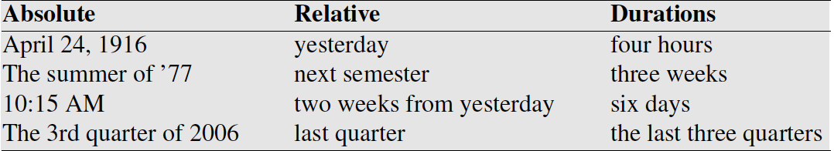
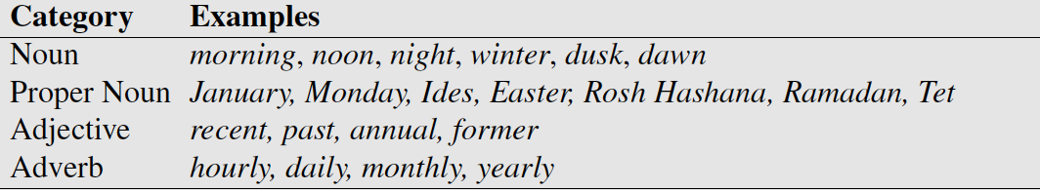
Temporal Expressions
Lexical triggers for temporal expressions:
Temporal normalization
mapping a temporal expression to either normalization a specific point in time or to a duration

Slide 29
Other Temporal Phenomena
Order – a pair of events can precede or follow each other, they or overlap and may have different onset times.
Duration – we might want to model how long an event typically takes
I went to college to get a degree
I went to the salon to get a haircut
Frequency / periodicity
Presidential elections take place ever 4 years
Stationarity – permanent versus impermanent events
The Statue of Liberty is in New York
The Coronavirus is in New York

Slide 30
Description Logic
Description Logics use ontologies to encode relationships between type of entities, and allow us to specify rules associated with certain types like
ItalianRestaurant ⊑ Restaurant⊓∃hasCuisine.ItalianCuisine

Slide 31
Conclusion
Formal meaning representations that capture the meaning-related content of linguistic inputs. These representations are intended to bridge the gap from language to common-sense knowledge of the world.
Meaning representation languages like FOL specify syntax and semantics of these representations. Many others have been used in NLP and AI.
Important elements of semantic representation including states and events can be captured in FOL.
Modelling temporal phenomena is an important challenge.

Slide 32
Information Extraction
Jurafsky and Martin Chapter 18
Notes:
Stanford Question Answering Dataset (SQuAD) consists of passages from Wikipedia and associated questions whose answers are spans from the passage, for just over150,000 questions.

Slide 33
Information Extraction (IE)
Information extraction (IE), turns the unstructured text information into structured data
Populate a relational database to enable further processing, support queries
Notes:
Example of building semantic reprentation:
What states border Texas? → ƛx:state(x)^borders(x; texas),
When was Ada Lovelace born? → birth-year (Ada Lovelace, ?x).

Slide 34
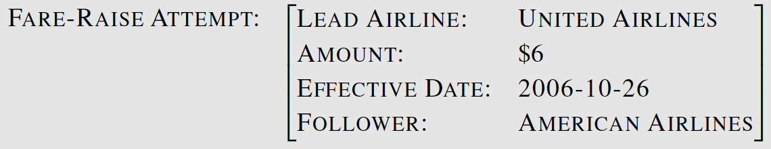
Template Filling
Citing high fuel prices, United Airlines said Friday it has increased fares by $6 per round trip on flights to some cities also served by lower cost carriers. American Airlines, a unit of AMR Corp., immediately matched the move, spokesman Tim Wagner said. United, a unit of UAL Corp., said the increase took effect Thursday and applies to most routes where it competes against discount carriers, such as Chicago to Dallas and Denver to San Francisco.

Slide 35
Steps in IE
NER and co-reference resolution
relation extraction
spouse-of, child-of, employer-of, partof, membership-in, located-in
event extraction
temporal expression normalization
template filling

Slide 36
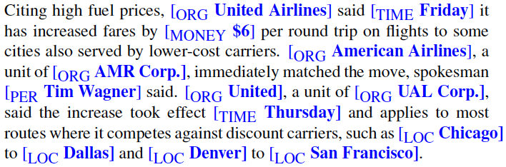
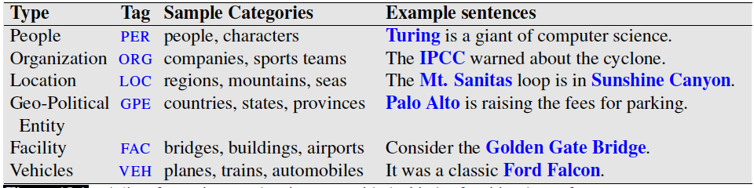
Named Entity Recognition

Slide 37
Named Entity Recognition
Find spans of text that constitute proper names
Ambiguity of segmentation
What’s an entity and what isn’t
Where the boundaries are
Classify the type of the entity
Type ambiguity

Slide 38
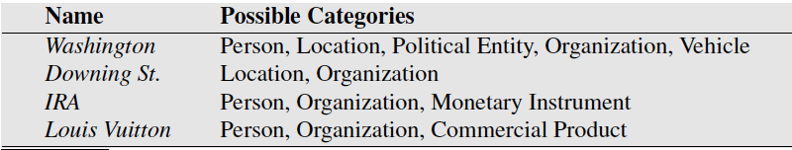
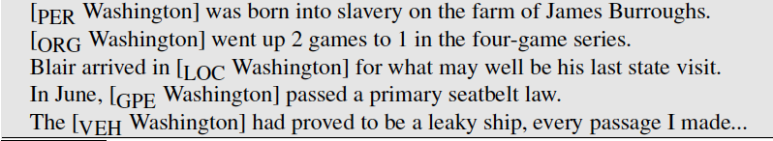
Category Ambiguity in NER
Examples of type ambiguities in the use of the name Washington

Slide 39
NER Algorithms & Evaluations
Word to word sequence labelling
Capture boundary and type
Feature based
Neural
Precision, Recall, F1
Segmentation component can cause problems
Notes:
Segmentation component problem example:
A system that labeled “American” but not “American Airlines” as an organization would cause two errors, a false positive for O and a false negative for I-ORG.

Slide 40
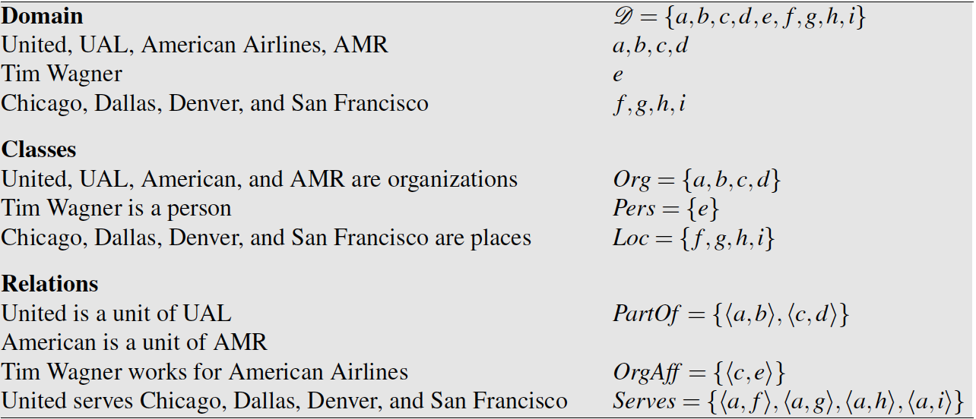
Relation Extraction
A relation consists of a set of ordered tuples over elements of a domain
The domain elements corresponds to the named entities

Slide 41
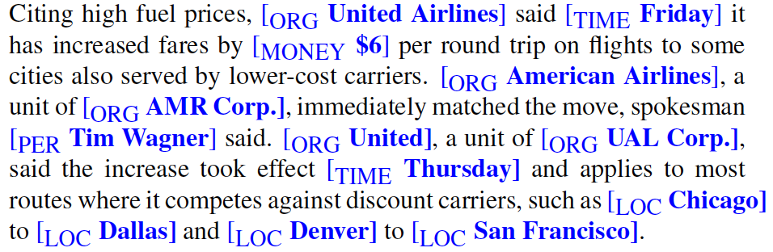
Tim Wagner [is a spokesman] for American Airlines.
United [is a unit of] UAL Corp.
American [is a unit of] AMR.

Slide 42
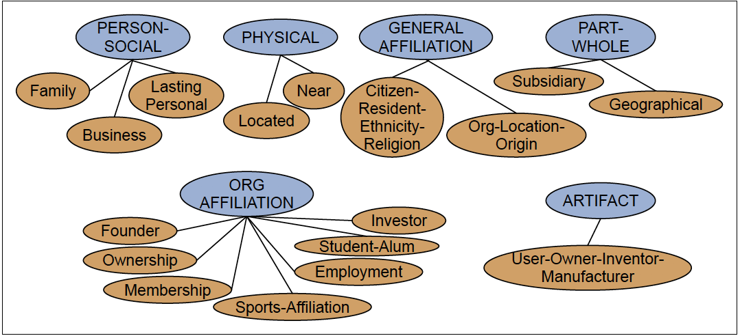
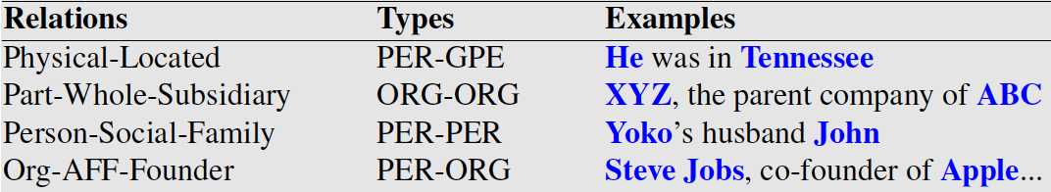

Slide 43
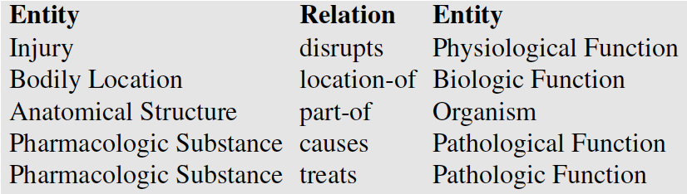
Unified Medical Language System
Given a medical sentence like:
Doppler echocardiography can be used to diagnose left anterior descending artery stenosis in patients with type 2 diabetes
Extract the UMLS relation:
Echocardiography (Doppler) Diagnoses Acquired stenosis

Slide 44
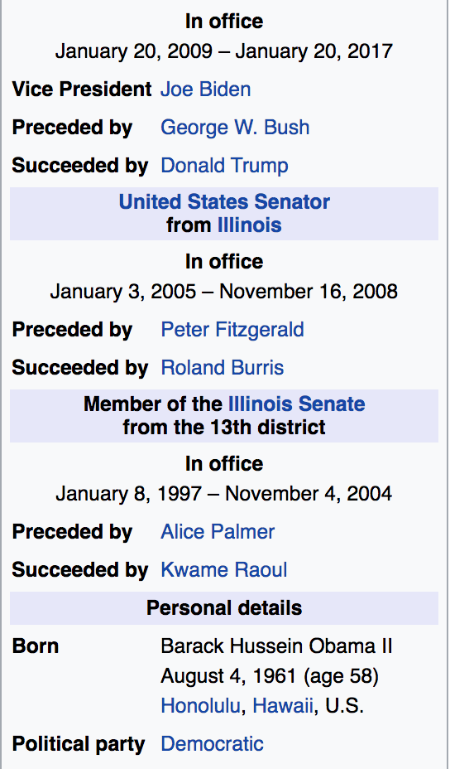
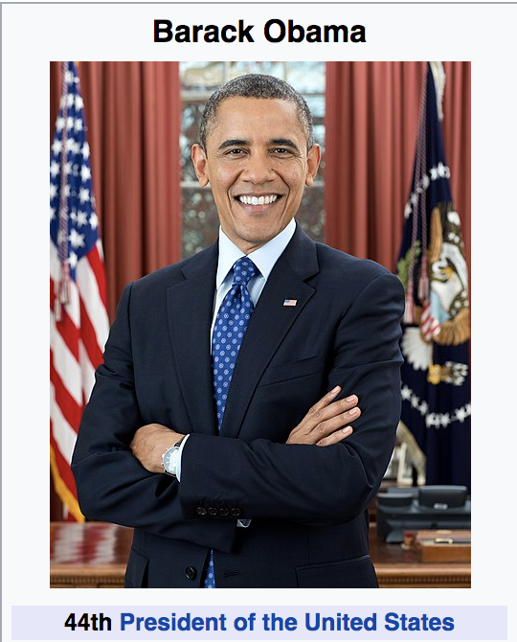
Wikipedia info boxes

Slide 45
RDF Triples
Resource Description Framework
RDF triple is a tuple of
Entity-relation-entity, aka
Subject-predicate-object expression
Subject: University of Pennsylvania
Predicate: location
Object: Philadelphia, PA

Slide 46
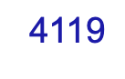
DBpedia is a community effort to extract structured information from Wikipedia and to make this information available on the Web. DBpedia allows you to ask sophisticated queries against datasets derived from Wikipedia and to link other datasets on the Web to Wikipedia data. We describe the extraction of the DBpedia datasets, and how the resulting information is published on the Web for human-and machine-consumption. We describe some emerging applications from the DBpedia community and show how website authors can facilitate DBpedia content within their sites. Finally, we present the current status of interlinking DBpedia with other open datasets on the Web and outline how DBpedia could serve as a nucleus for an emerging Web of open data.

Slide 47
Freebase, WordNet, other ontologies
Freebase relations:
people/person/nationality
location/location/contains
people/person/place-of-birth
biology/organism classification
WordNet relations:
is-a, instance-of
hypernyms/hyponyms
Giraffe is-a ruminant is-a ungulate is-a mammal is-a vertebrate is-a animal…

Slide 48
Strategies for relation extraction
Hand-written patterns
Supervised machine learning
Semi-supervised machine learning
Bootstrapping
Distant supervision
Unsupervised machine learning

Slide 49
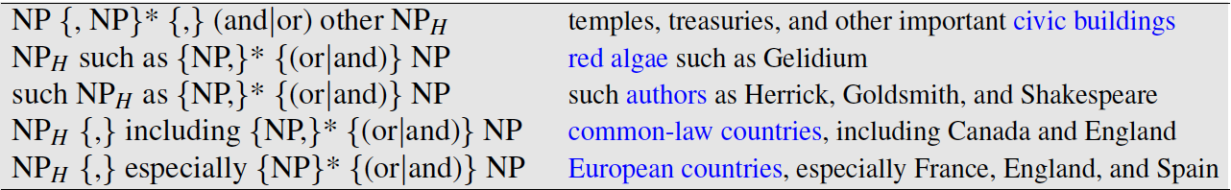
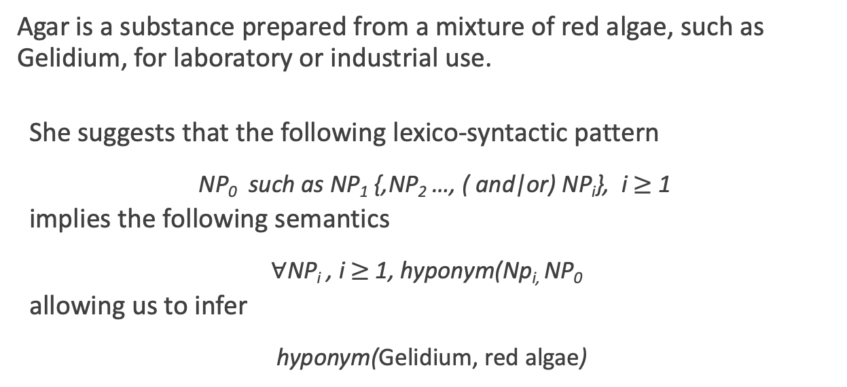
Hearst Patterns
Agar is a substance prepared from a mixture of red algae, such as Gelidium, for laboratory or industrial use.
She suggests that the following lexico-syntactic pattern
NP₀ such as NP₁ {,NP₂ …, ( and|or) NP_{i}}, i $≥$ 1
implies the following semantics
$∀$NP_{i} , i $≥$ 1, hyponym(Np_{i,} NP₀
allowing us to infer
hyponym(Gelidium, red algae)

Slide 50
Machine learning techniques
Supervised: training corpus annotated with manually annotated with fixed set of relations and entities
Semi-supervised: high-precision seed patters, or seed tuples, are used to bootstrap more examples
Distant supervision: start with a huge number of seeds, learn noisy pattern fields (e.g. 100k examples of birth-place-of from infoboxes, help learn the corresponding text patterns)

Slide 51
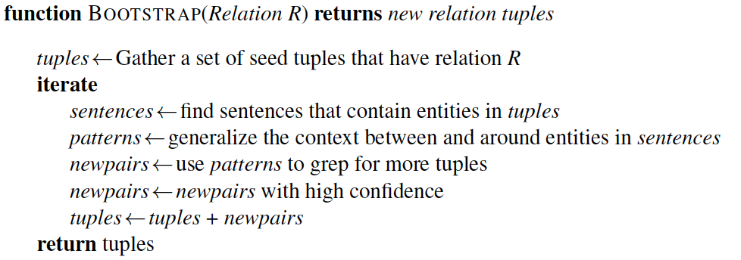
Semisupervised Relation Extraction
Bootstrapping proceeds by taking the entities in the seed pair, and then finding sentences (on the web, or whatever dataset we are using) that contain both entities.

Slide 52
Example
Task: Create airline/hub pairs
Seed: Ryanair has a hub at Charleroi
use this seed fact to discover new patterns by finding other mentions of this relation in our corpus
Sentences found:
Budget airline Ryanair, which uses Charleroi as a hub, scrapped all weekend flights out of the airport.
All flights in and out of Ryanair’s Belgian hub at Charleroi airport were grounded on Friday...
A spokesman at Charleroi, a main hub for Ryanair, estimated that 8000 passengers had already been affected.
Patterns extracted:
/ [ORG], which uses [LOC] as a hub /
/ [ORG]'s hub at [LOC] /
/ [LOC] a main hub for [ORG] /

Slide 53
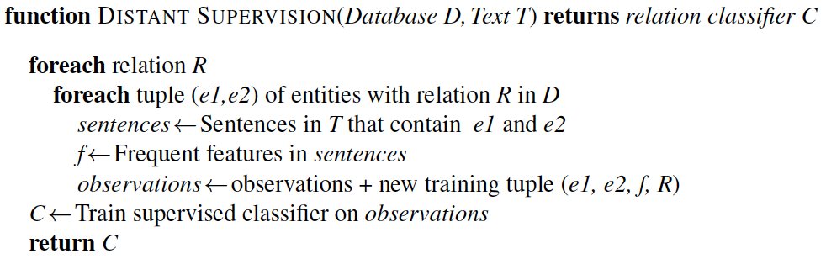
Distant Supervision
R: place of birth
(e1, e2): <Edwin Hubble, Marshfield>, <Albert Einstein,Ulm>, etc
Sentences: Hubble was born in Marshfield; Einstein, born (1879), Ulm; Hubble’s birthplace in Marshfield..., etc

Slide 54
Open IE
Unsupervised relation extraction
Find all strings of words that satisfy the tripe relation.
United has a hub in Chicago, which is the headquarters of United Continental Holdings.
r1: <United, has a hub in, Chicago>
r2: <Chicago, is the headquarters of, United Continental Holdings>

Slide 55
Evaluation of Relation Extraction
Supervised
Test sets with human annotated, gold-standard relations and computing precision, recall, and F-measure
Semi and Unsupervised
Human evaluations
Compute precision at different levels of recall

Slide 56
Temporal Expression Extraction
Lexical triggers for temporal expressions:
Temporal expression recognition
Temporal normalization
mapping a temporal expression to either normalization a specific point in time or to a duration
Notes:
Temporal normalization is the process of mapping a temporal expression to either a specific point in time or to a duration. Points in time correspond to calendar dates, to times of day, or both. Durations primarily consist of lengths of time but may also include information about start and end points.

Slide 57
Event Extraction
The task of event extraction is to identify mentions of events in texts. An event mention is any expression denoting an event or state that can be assigned to a point in time or an interval in time.
In English events are typically expressed verbs like exploded. However, there are also some nouns, like explosion, that denote an event.
Some “light verbs” like make, take, and have often do not denote events. Instead, the event is often expressed by the nominal direct object (took a flight).

Slide 58
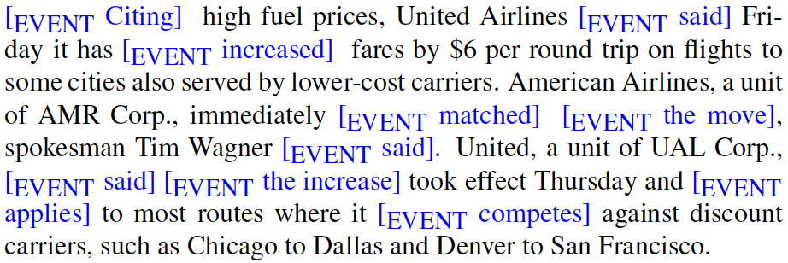
Event Extraction
Events can be classified as actions, states, reporting events, perception events, etc. The aspect, tense, and modality of each event also needs to be extracted.
Notes:
Reporting events:
Events are to be classified as actions, states, reporting events (say, report, tell, explain), perception events, and so on. The aspect, tense, and modality of each event also needs to be extracted.

Slide 59
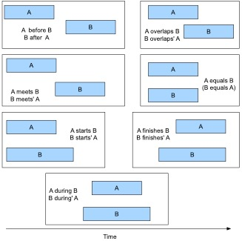

Slide 60
Temporal ordering of events
Delta Air Lines earnings soared 33% to a record in the fiscal first quarter, bucking the industry trend toward declining profits.
Soaring_{e1} is included in the fiscal first quarter_{t58}
Soaring_{e1} is simultaneous with the bucking_{e3}
Declining_{e4} includes soaring_{e1}

Slide 61
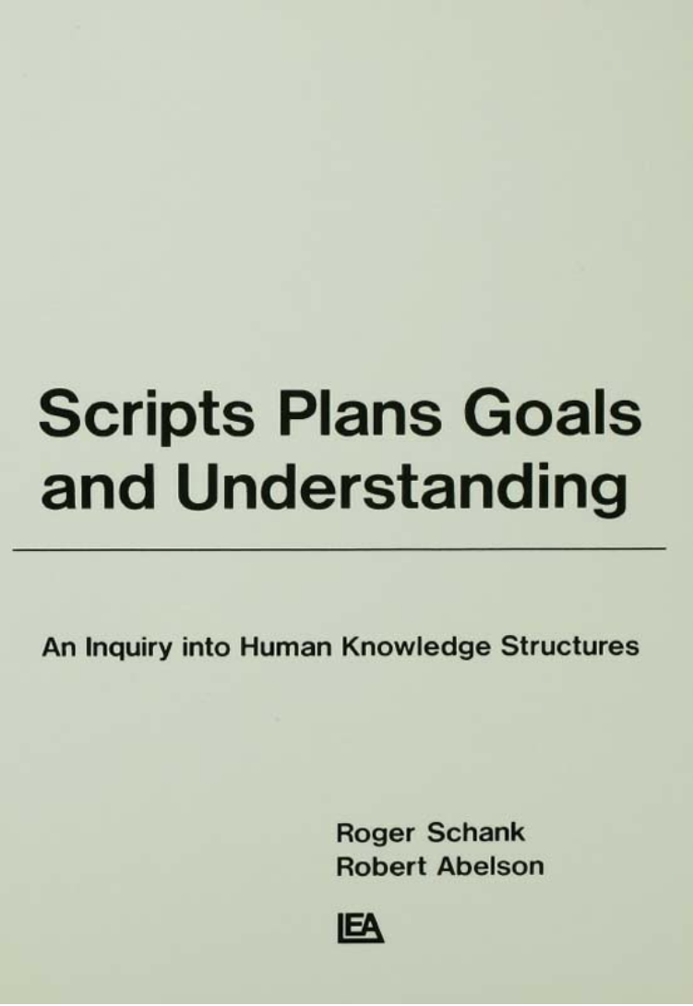
Scripts
How do people organize all the knowledge they must have in order to understand? How do people know what behavior is appropriate for a particular situation?
Scripts consist of prototypical sequences of sub-events, participants, and their roles.
The strong expectations provided by these scripts can help with the classification of entities, the assignment of entities into roles and relations.
Most critically scripts can be used to draw inferences that fill in things that have been left unsaid.

Slide 62
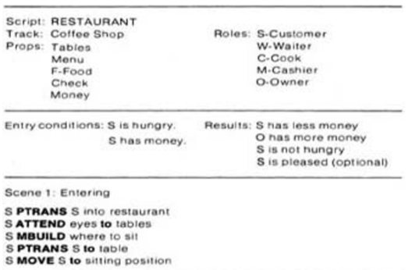
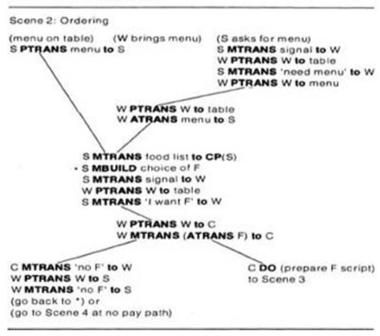

Slide 63
Prosecution Chain
Employment Chain
Notes:
Arrows indicate the before relation.
Dotted lines indicate incorrect before relations.

Slide 64
Narrative Cloze Test
A cloze test removes words from a text and asks the participant to fill in the missing language item. Cloze tests require the ability to understand context and vocabulary in order to identify the correct language or part of speech that belongs in the deleted passages. This exercise is commonly administered for the assessment of native and second language learning and instruction.
Today, I went to the ________ and bought some milk and eggs. I knew it was going to rain, but I forgot to take my ________, and ended up getting wet on the way.

Slide 65
Narrative Cloze Task
Narrative Cloze Task
event₁ event₂ ________ event₄ … event_{n}
What word should fill in the gap?
take → nsubj
tell → nsubj
see → nsubj
…
persuade → dobj
sail → nsubj
regard → dobj
Event vocabulary

Slide 66

Template Filling
Templates represent scripts with a fixed set of slots that take slot-filler values
Train two separate supervised systems
Template recognition
Role-filler extraction
Most earlier systems were based on handwritten regular expressions and grammar rules.

Slide 67
The Gun Violence Database
http://gun-violence.org/
Ellie Pavlick and Chris Callison-Burch, University of Pennsylvania

Slide 68
Goals of the GVDB
Collect data about gun violence in the US to facilitate public health research.
Draw sample from local newspapers and television stations that publish online.
Use machine learning and crowdsourcing to extract structured data from text.

Slide 69
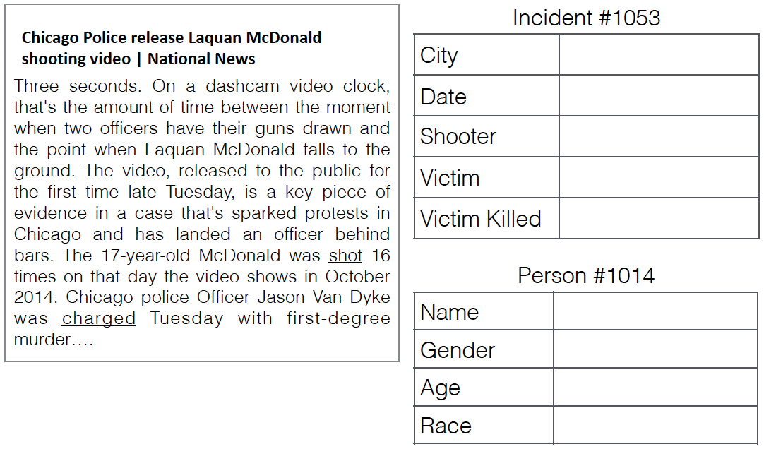
GVDB Template

